Slide 1
The Future is local
John Huige

Slide 2
Maastricht Presentation april 16 2012
Short introduction
General societal survey
Sustainability and / or resilience
The importance of the region
The economic & financial aspects
The political dimensions
Creative cities & creative regions
Possible actions

Slide 3
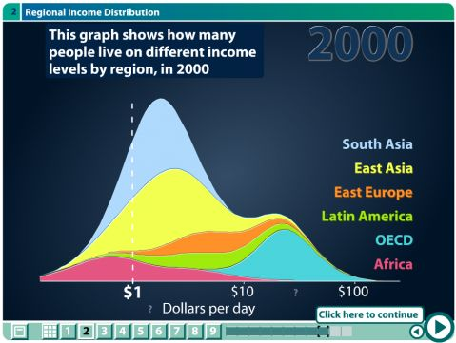
1 General societal survey
  Take a car & double the speed every 30 years
  Climate growing urgency: waiting for the tipping points
  Trivial politics : lets give it to the market
  Cosmopolitism: a threat for those who stay behind
  Global poverty:

Slide 4
2 Sustainability and resilience
Sustainability : “Sustainable development is development that meets the needs of the present without compromising the ability of future generations to meet their own needs.” (Brundtland Commission, 1987)
Resilience: the ability to go on functioning after a disturbance and possibly regain the original system strength. This holds for the earth: people and nature
  Economic crisis: unemployment, income loss
  and ecological crisis: e.g. The Dutch ecological main structure EHS

Slide 5
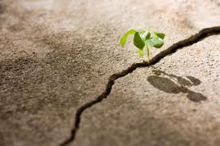
Resilience involves 3 elements
The ability to absorb perturbations and still retain a similar function;
The ability of self-organisation and the capacity to learn;
The ability to change and to adapt. (Monaghan)
Hard to make because it involves organisations that are self referential.
Hard to break because
of these 3 elements!
Resilience is a strategy against
defragmentation.

Slide 6
3 The importance of the region
Contributes to a more sustainable & resilient society (slides 9/10)
Social cohesion & territorial cohesion (EU)
The subsidiarity principle (EU)
  Organize at the lowest, smallest, or least centralized competent authority
Example: Localism act UK: 5 key measures:
  Community rights
  Neighbourhood planning
  Housing
  Empowering cities and other local areas
  General power of competence
From neighbourhood to region: The right size: NEF http://www.neweconomics.org/

Slide 7
Unit | District | Region | Nation | Continent | Globe
Size (miles) | 20 | 100 | 500 | 2000 | 10,000
Production | Food crops | Building materials | Clothes, textiles | Vehicles | Micro-chips
 | Cash crops | Processed food | Small machines & components | Electronic systems | Pharma-ceuticals
 | Housing | Furniture | Electronic devices | Small aircraft | Large aircraft
 |  | Hardware | Steel | Ships
 | Energy (micro-renewables) | Renewable energy (wind, hydro, solar) | Oil, gas, coal
 | Energy-efficiency, housing retrofitting |  | Civil engineering
 |  |  | Books, films, bicycles
Distribution | Fresh food | ‘Groceries’ | Bulk commodities, e.g., grain | Oil, gas
 | Daily supplies | Clothes | Industrial machinery
 |  | Books
 |  | Cars
 |  | Household appliances
 |  | Seeds
Services | Schooling | Universities | Insurance | Aviation
 | GP medical | Hospitals | Railways | Shipping
 | House repair | Public health | News Media
 | Restaurants | Safety | Telecom
 | Hotels | ‘High street’ and local banking | Wholesale banking
 | Waste recycling | Buses | Electricity
 |  | Theatre/cinema
 |  | Water

Slide 8
Unit | District | Region
Size (miles) | 20 | 100
Production | Food crops | Building materials
 | Cash crops | Processed food
 | Housing | Furniture
 |  | Hardware
 | Energy (micro-renewables) | Renewable energy (wind, hydro, solar)
 | Energy-efficiency, housing retrofitting
Distribution | Fresh food | ‘Groceries’
 | Daily supplies | Clothes
 |  | Books
 |  | Cars

Slide 9
4 Economic & financial aspects
(SDC, http://www.sd-commission.org.uk/pages/the-future-is-local.html)
Area-based retrofit programmes can deliver a host of economic, environmental and social co-benefits for the same or similar cost outlay. As detailed in the report these works have the potential to:
• Reduce carbon emissions
• Make efficient use of resources
• Improve energy security
• Make places more resilient to climate change
• Improve biodiversity
• Create local jobs
• Strengthen local economies
• Improve the quality and value of existing places
• Reduce fuel poverty
• Improve health and reduce health inequalities
• Strengthen communities; improve community interaction.

Slide 10
Economic & financial impact II
Shorter supply chains
Combining & closing of supply chains
Organize local food production & distribution
Improve transparency
Enlarge social support (slide 12)
  Reclaim the commons

Slide 11
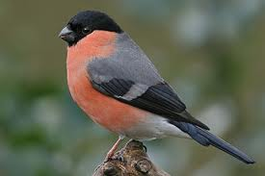
Economic & financial impact III
Green investment bank
New local / regional savings bank(s)
Complementary currencies
New business models
Create a local feed in system
L.E.T.S.
Crowd funding
Financial guarantees
government buying
Find a:

Slide 12
5 The political dimensions
Democracy needs new impulses;
Left - right schemes are changing
Delibarative democracy (Habermas)
For the region:
Direct political involvement. It matters what you do!
Easier to organise popular support
Combine formal and informal political actions
Round tables
The importance of the 4 E’s (Jackson):
    Enable
    encourage
    Exemplify
    engage

Slide 13
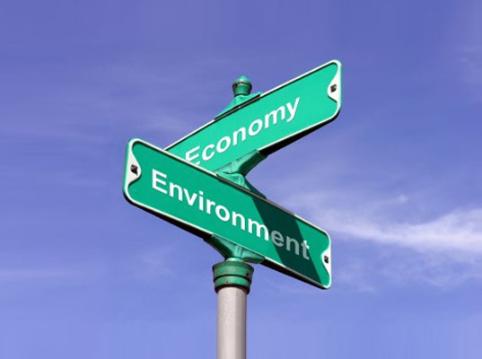
Instruments to pursue local resilience
Research:
  Study plans of local government coalitions (and find quotes to use)
  Study the local social chart (what institutions are the; how do they operate; what are there aims etc)
  Describe the necessity for local resilience (local unemployment, food bank, diminishing nature, more social cohesion etc)
Actions:
  Organise local support
  Measure the local footprint
  Start a chapter of transition towns
Media strategy
  New / old media

Slide 14
Local participants in neighbourhood partnerships
Provinces / communities (& departments within these structures)
Local authorities: public transport, public health, education (at all levels), housing agencies (woningcorporaties), utility companies, museums, theaters etc.
Others: NGO’s (nature, landscape, cultural)
Responsible private corporations
Cultural & creative industries

Slide 15
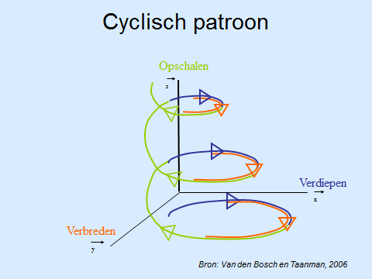
Transition cycle(s)

Slide 16
6 Creativity & sustainability
Creativity & sustainability & transition cycles:
  Develop new visions, new narratives (video, architecture)
  (co-) create agenda’s (information sector, theatre)
  Reconceptualize design &production processes (design, new form of co-creation)
  Monitoring &learning processes (film, education)
Creativity & sustainability experts:
  working to reduce the direct footprint of the industries;
  working to enhance the creative persuasion they can have on society and;
  working to promote technology and innovation for sustainability.
  working to promote sustainability in the field of education and research.
  Promoting sustainability by practicing what you preach & preach what you practice

Slide 17
Creativity & entrepreneurship
Core business of entrepreneurs in the CI (EU EACEA report: the entrepreneurial dimension of the cci’s, 2010) & entrepreneurial behaviour:
  Developing new and innovative products;
  Proposing new forms of organization;
  Exploring new markets;
  Introducing new production methods;
  Searching for new sources of supplies and materials.

Slide 18
Creative cities & creatives
Creative city & the creatives; Ray and Anderson values of creatives:
  Authenticity, actions must be consistent with words and beliefs
  Engaged action and whole process learning; seeing the world as interwoven and connected
  Idealism and activism
  Globalism and ecology
  The importance of women
  Core Cultural Creatives also value altruism, self-actualization, and spirituality.

Slide 19
Creative regions
“Creative region: area with a characteristic & recognizable cultural & creative signature in interaction with a city (of a network of cities) and the surrounding country side”. (Hagoort 2007)
To stand out as a creative region one needs an ambition (or 2):
Develop new images, a new language for new democratic instruments;
Formulate the aesthetics of sustainability.
Apply them to the possible actions mentioned here after.

Slide 20
7 8 Possible actions / projects
National parks /national landscapes
Energy projects
Green projects (green schools, green cities etc.)
Traffic projects (e.g. traffic queues)
Regional art lab’s
Establishing resilience centers (industrial areas & living areas)
Shrinking population does not imply shrinking creativity http://provincie.zeeland.nl/milieu_natuur/lvdo/projecten/transities
Educational & research projects.

Slide 21

Thank you for your

